Slide 1
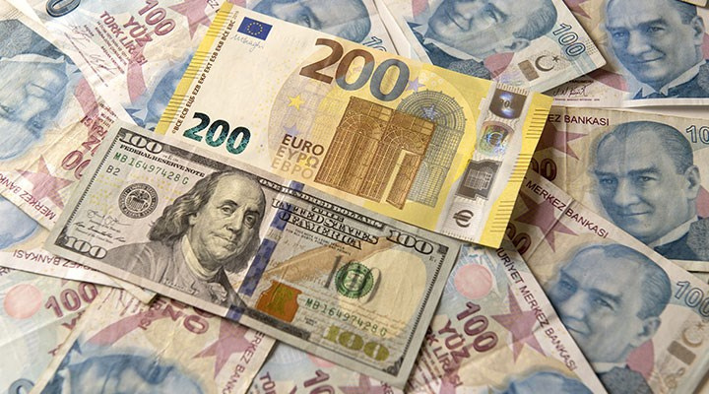
LET'S TALK ABOUT
NOLCAKTI
Kİ
DATA SCIENCE FOR SOCIAL GOOD IN TÜRKIYE
TOURISM & TURKISH LIRA
HALIL IBRAHIM UMUT ÇOLAK
ÜMIT ERKUT ÇOLAK
KERIM DEMIR
ELIF EZGI TUNCAL
DEFNE ORHAN
CEVDET ÖZEN

Slide 2
SOCIAL GOOD IN TÜRKIYE
"Social good" refers to actions or outcomes that bring about positive impact and benefit society as a whole.
Education Improvement
Healthcare Access
Environmental Sustainability
Social Services Optimization
Economy

Slide 3

TOURISM IN TÜRKIYE & TURKISH LIRA
A decline in the value of the currency may lead to an increase in tourism, as it becomes more affordable for foreign visitors to travel and spend in the country.

Slide 4

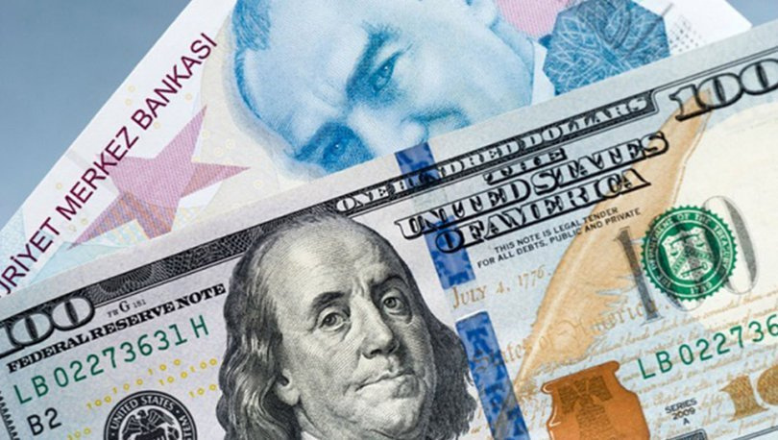
OUR HYPOTHESIS
The depreciation of the Turkish lira leads to an increase in tourism in Turkey.
foreign tourists & cost-effective to visit the country
prices of goods, services, accommodations, and attractions

Slide 5
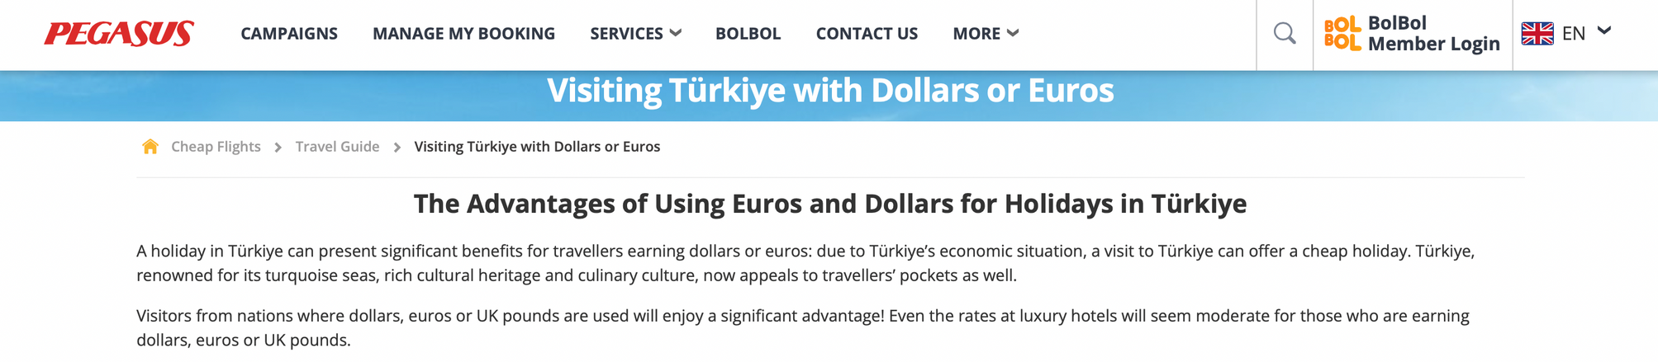
AN APPROACH FROM WITHIN: PEGASUS

Slide 6
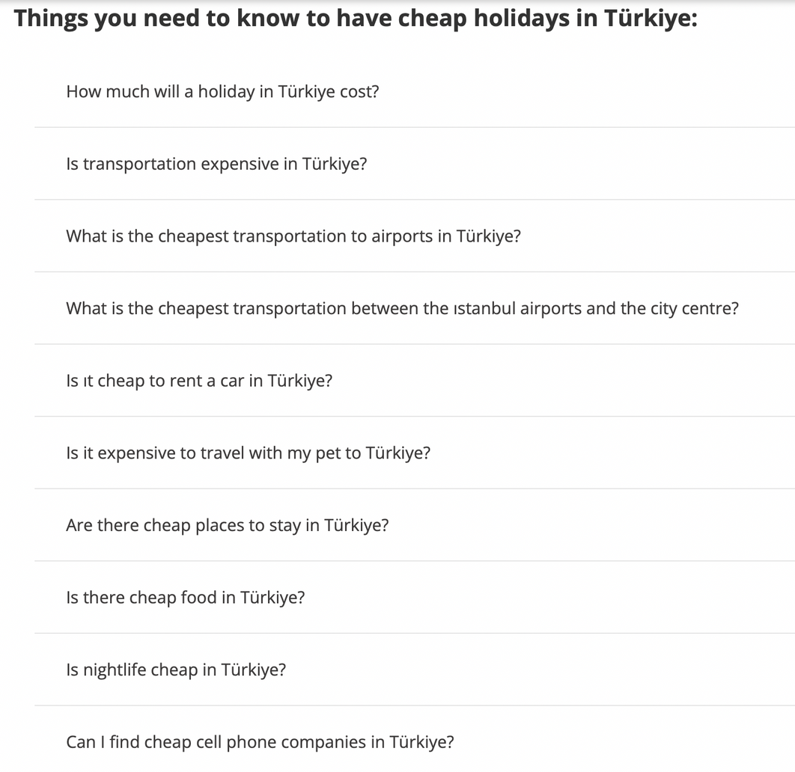
AN APPROACH FROM WITHIN: PEGASUS

Slide 7





DATASET SOURCES
Turkish Statistical Institute (TUİK)
Central Bank of the Republic of Turkey
Ministry of Culture and Tourism
Association of Turkish Travel Agencies (TÜRSAB)
Ministry of Treasury and Finance

Slide 8
DATASETS
Tourism Income, Expenditure and Average Number of Nights, 2012 - 2023
Tourism Income of Turkish Citizens Resident Abroad and Average Expenditure Per Capita, 2012 - 2023
Tourism Income and Average Number of Nights of Turkish Citizens Resident Abroad, 2012 - 2023
Tourism Income of Turkish Citizens Resident Abroad and Average Expenditure Per Capita, 2012 - 2023
Tourism income, number of visitors and average expenditure per capita by months, 2012 - 2023
TURİZM GELİRLERİNİN İHRACAT GELİRLERİ VE TURİZM GİDERLERİNİN İTHALAT GİDERLERİ ORANI
2018-2020 YILLARINDA ÜLKEMİZE GELEN YABANCI ZİYARETÇİLERİN MİLLİYETLERİNE GÖRE KARŞILAŞTIRILMASI (OCAK - EKİM)
OCAK AYINDA GELEN DIŞ HAT YOLCULARININ MİLLİYETLERİNE GÖRE DAĞILIMI
A Geographic view on the Touristic Accommodation Type and Distribution in Turkey
TURİZM GELİRİ, GİDERİ ve ORTALAMA HARCAMANIN YILLARA GÖRE DAĞILIMI
exchange-rates
TUFE-bazlı-reel-efektif-döviz-kuru
ÜLKEMİZE GELEN YABANCI ZİYARETÇİLERİN MİLLİYETLERİNE GÖRE DAĞILIMI (2006 - 2021)

Slide 9
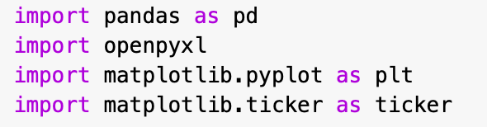
TECHNIQUES
Data processing
Excel processing
Data transformation
Data visualization
Graph customization (ax.set_xlabel, ax.set_ylabel, ax.set_title, etc.)
Data labels
Bar chart
Twin axes
Line graph
Axis labeling
X-axis label rotation
Title
Graph display
Data extraction
Data conversion
Line plot
Appearance customization
X-axis limits
Layout adjustment
Data manipulation
Data sorting
Filtering
Pie chart creation & plotting
Label customization
Data filtering
DATA CLEANING
Drop the columns or rows that including missing values
to ensure data quality and integrity

Slide 10
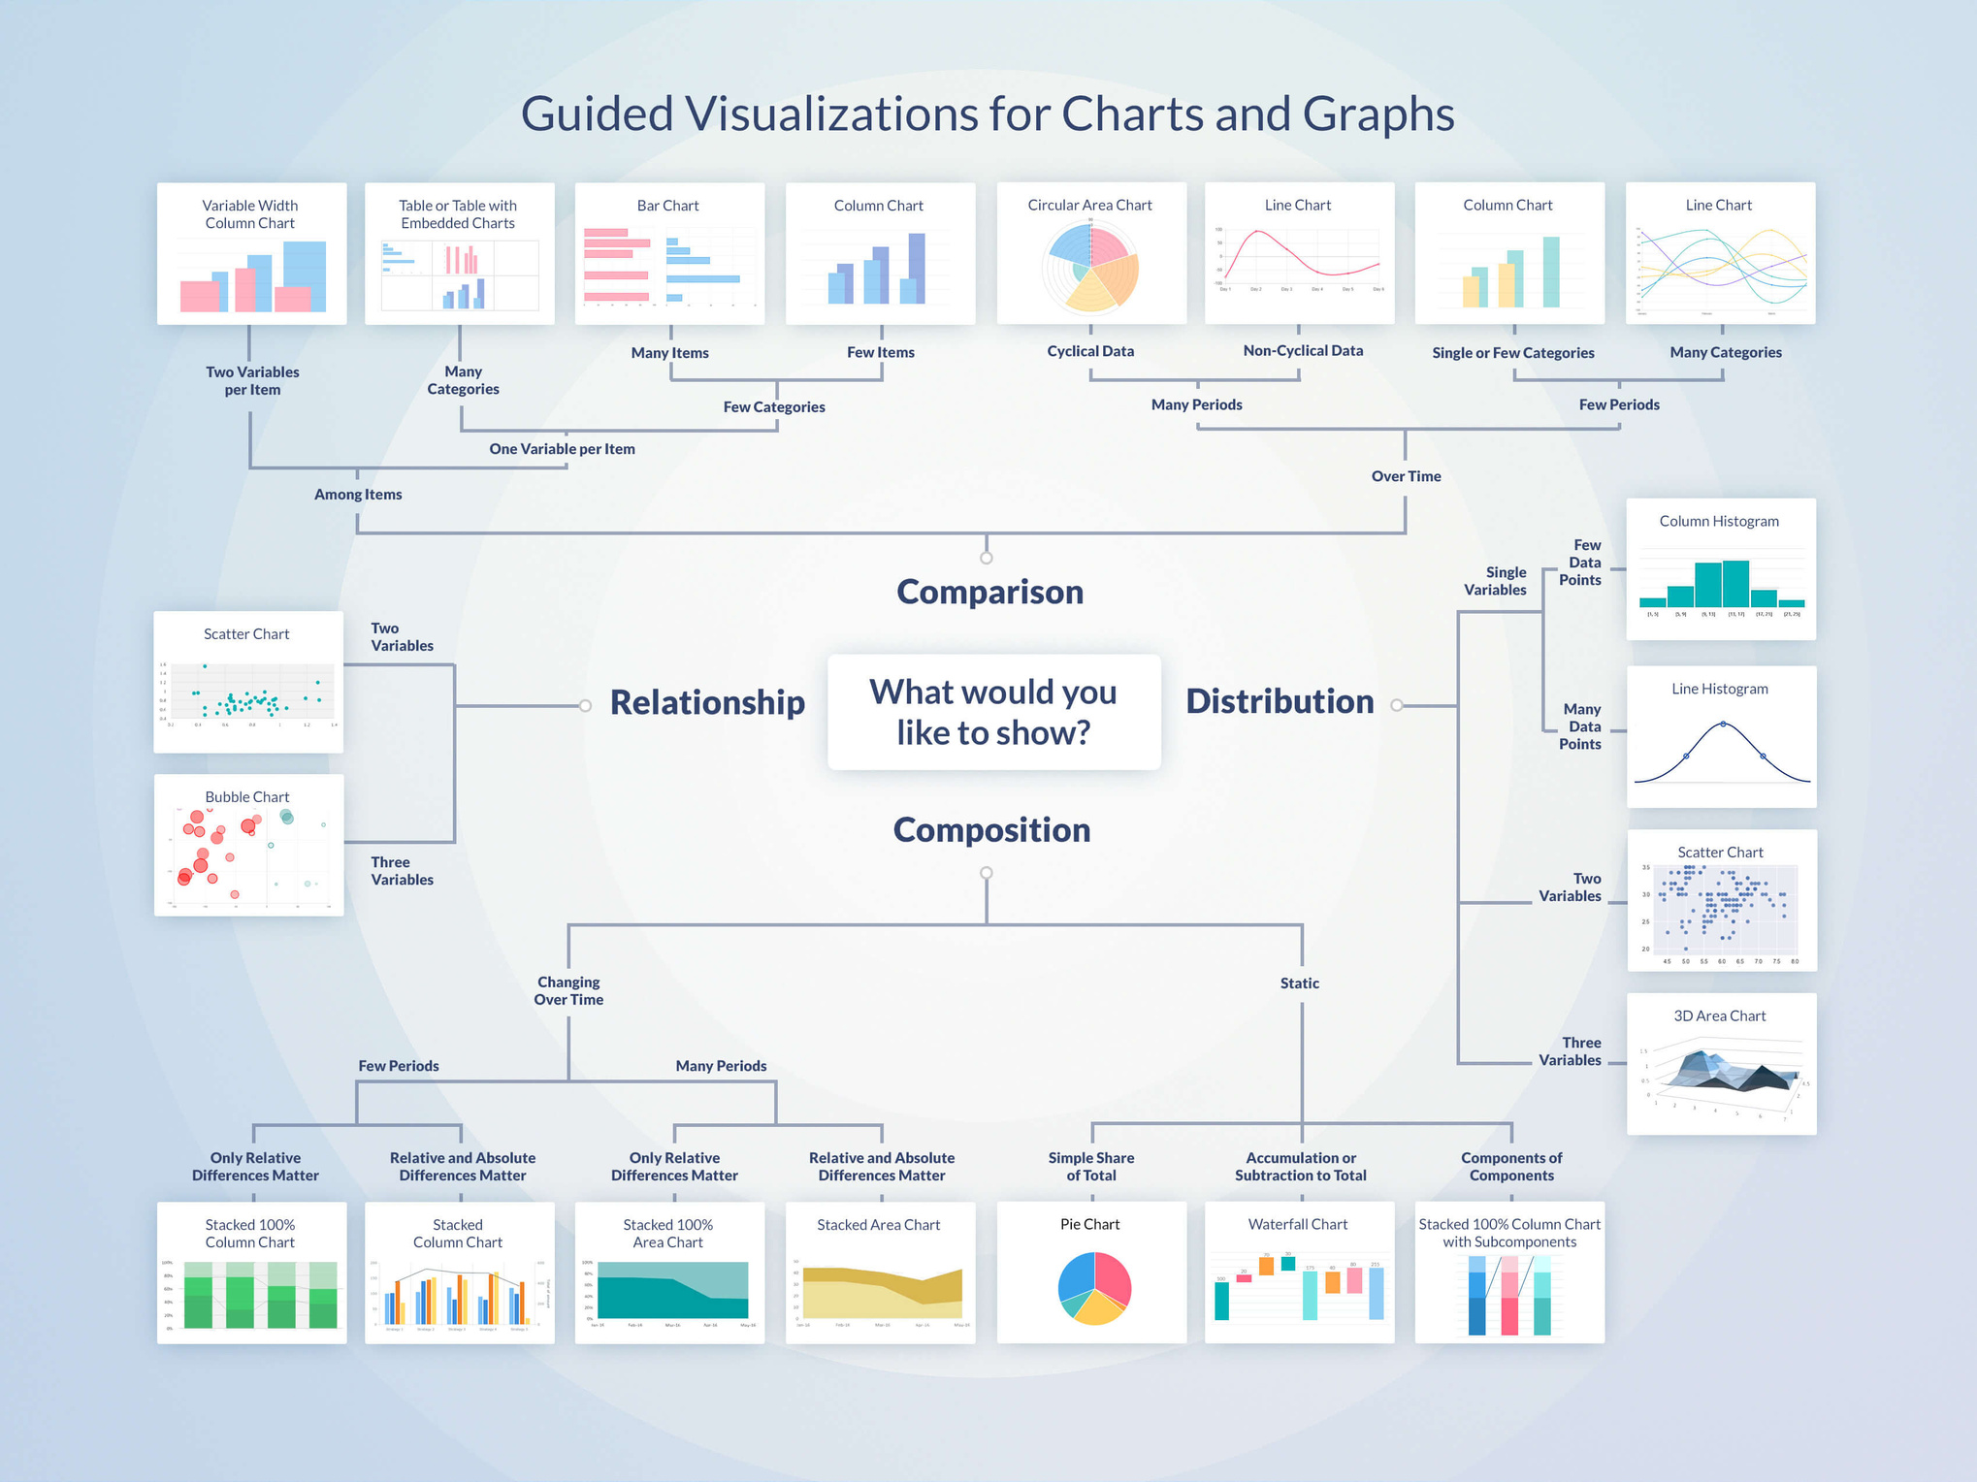

VISUALISATION

Slide 11
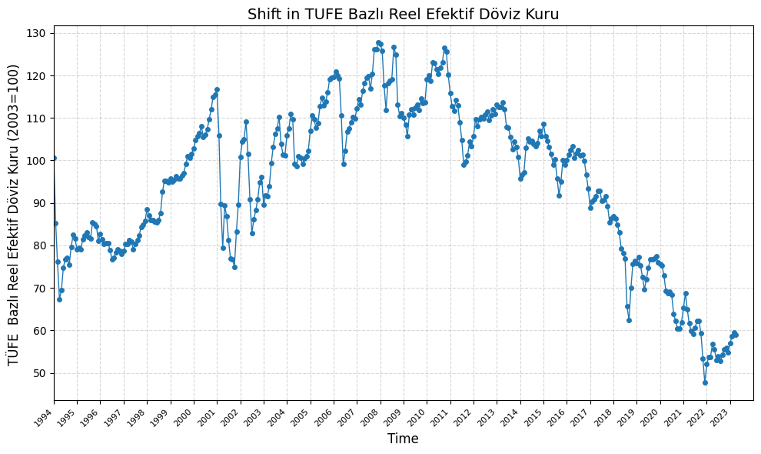
Connected scatter plot

Slide 12
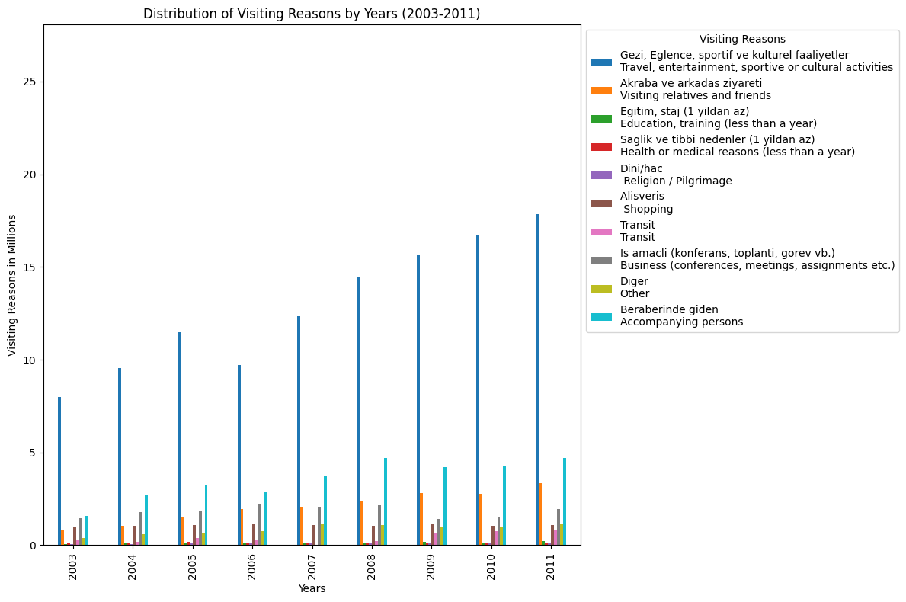
Grouped bar chart

Slide 13
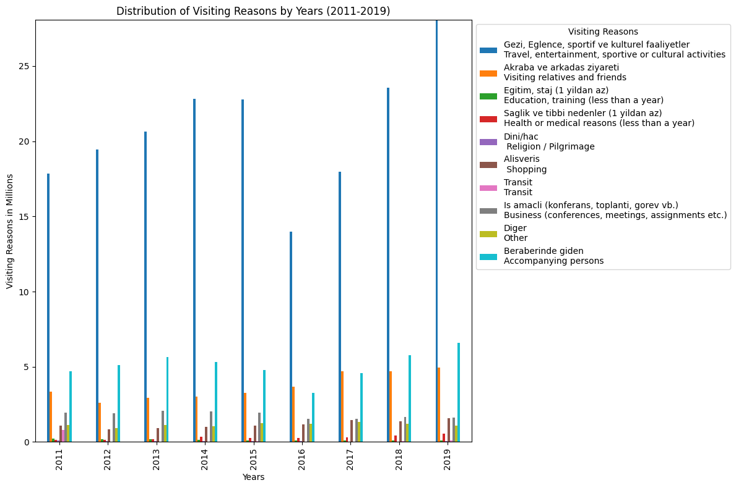
Grouped bar chart

Slide 14
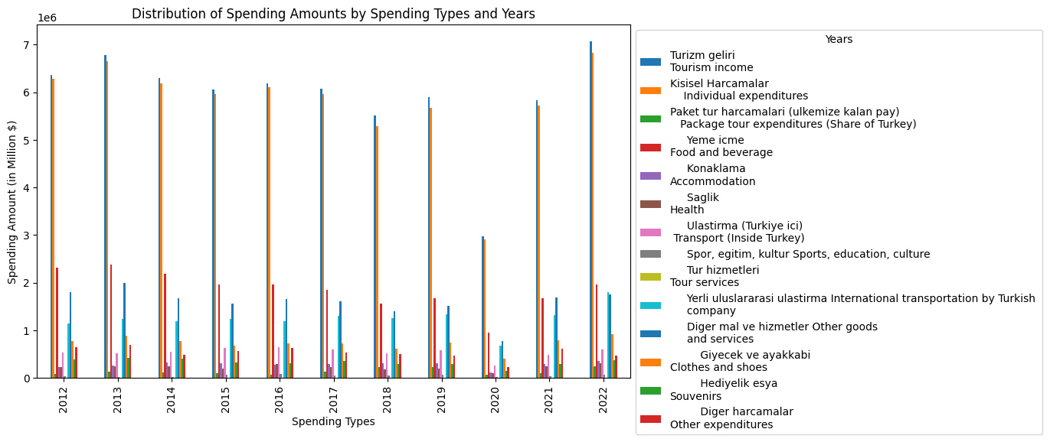
Grouped bar chart

Slide 15
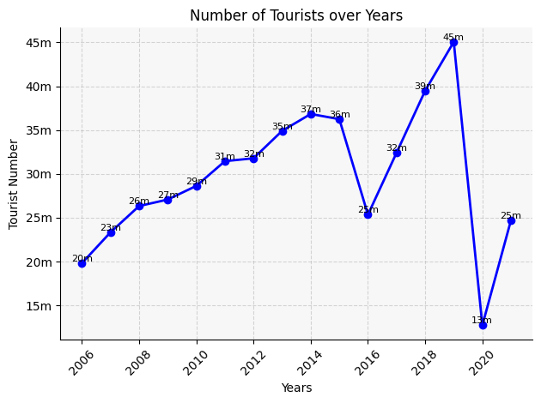
Exchange Rates and Affordability
Political Stability and Security(2016)
COVID-19 Pandemic (2020)
Line chart

Slide 16
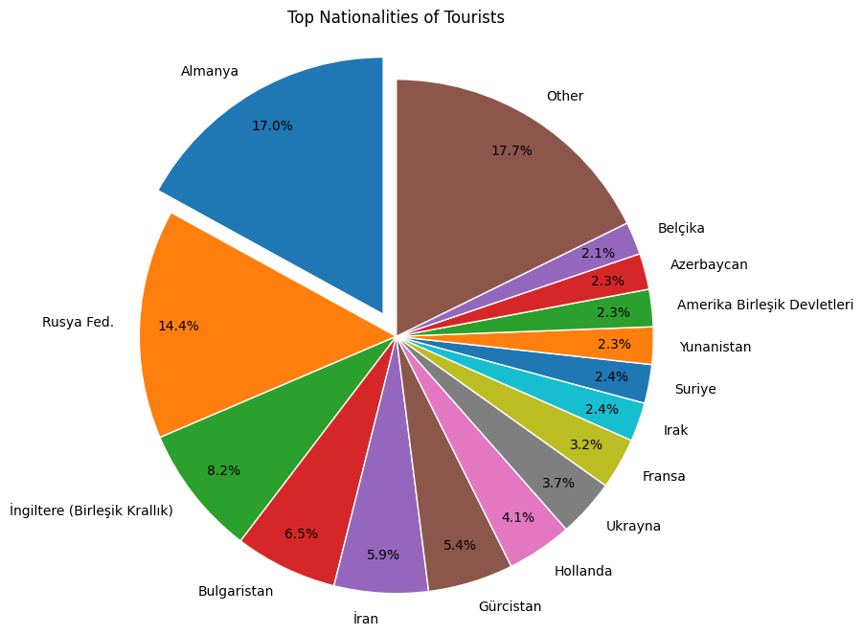
Pie chart

Slide 17
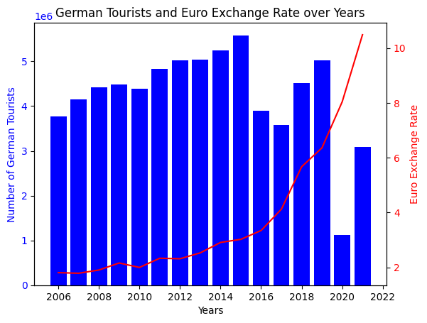
.
Economical Growth
Security and Visa restrictions: (2015-2016)
The COVID-19 pandemic:
(2020)
Exchange Rate
Column histogram

Slide 18
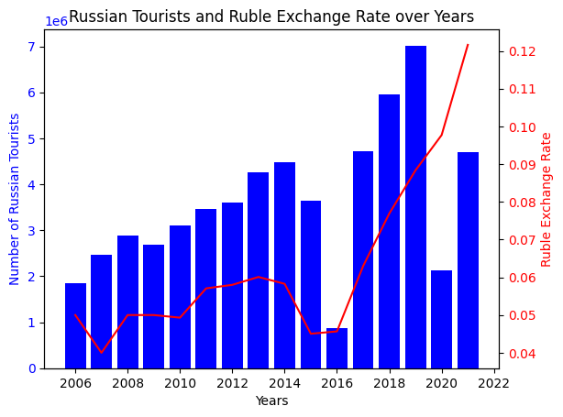
As it is easily accessible with shorter travel distances Turkey is favorite place for Russian turists.
Political Relations: (2015-2016)
The COVID-19 pandemic:
(2020)
Exchange Rate
Column histogram

Slide 19
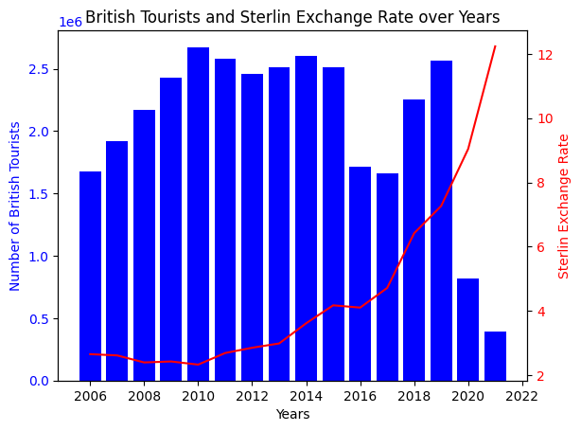
British tourist numbers to Turkey showed a general upward trend from 2006 to 2019, indicating a growing interest in the destination among British travelers.
Economic Factors
Seasonal Pattern:(2020-Present)
Covid-19 Pandemic:(2020)
Column histogram

Slide 20
HYPOTHESIS TESTING
We got the data as in our code.
After that we extract the rows where the data is above average to determine if there is a correlation between TL and tourism in Turkey.
After that we apply randomized test where we pick a random year from 3 of the arrays that contain above average data.
Then we check if in that year we have above average visitors, spendings and TL below the endex taken from "Tüfe bazlı reel efektif döviz kuru".
If all 3 checks out true then we put a 1 in the test_array indicating that there is a correlation, otherwise we put a 0 indicating not.
After that we calculate the p-value and compare it with the significance level (0.05).

Slide 21
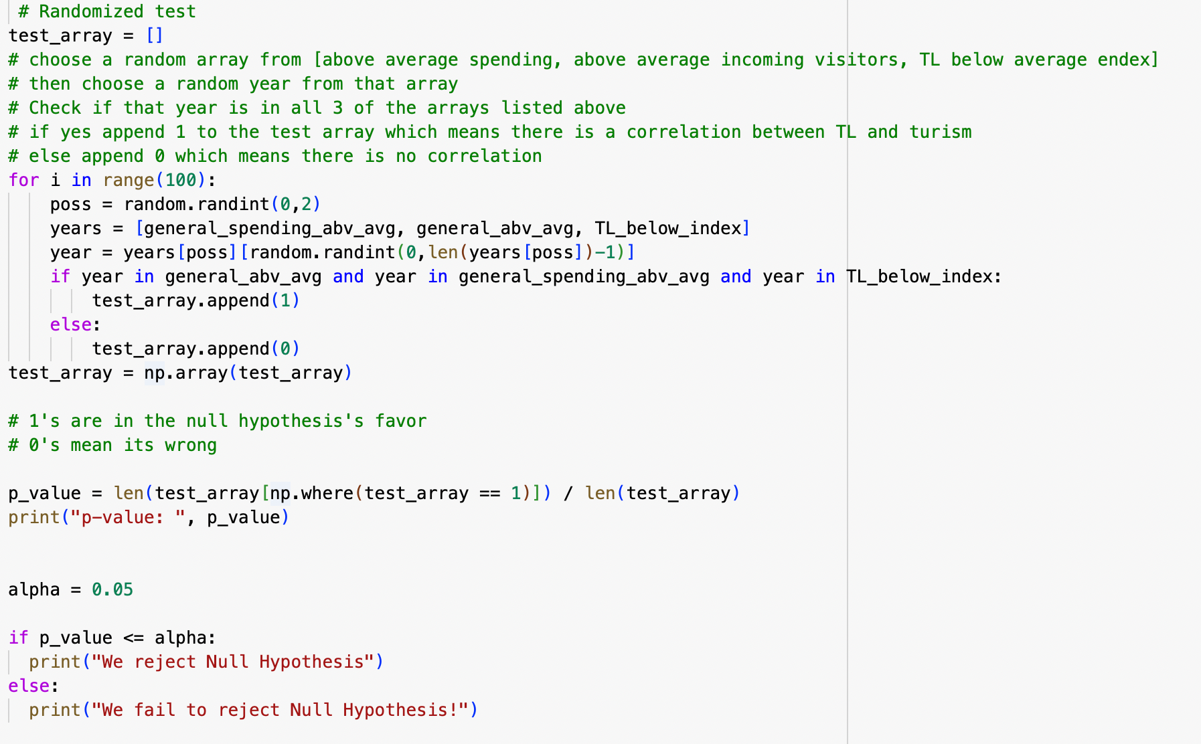
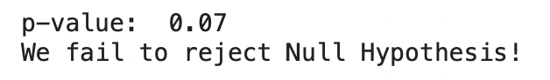
RANDOMIZED TEST
output:

Slide 22


HYPOTHESIS TESTING
NULL
ALTERNATIVE
The depreciation of the Turkish lira leads to an increase in tourism in Turkey.
The increase in the tourism in Turkey is not correlated with the depreciation of the Turkish lira.
p-value: 0.07
significance level: 0.05
Since p-value > significance level, We fail to reject Null Hypothesis!

Slide 23








SUMMARY
Data Cleaning and Visualization
Topic selection
Data Collection
Reject/Do not Reject Decision
Hypothesis Testing
Tables and Explanations

Slide 24

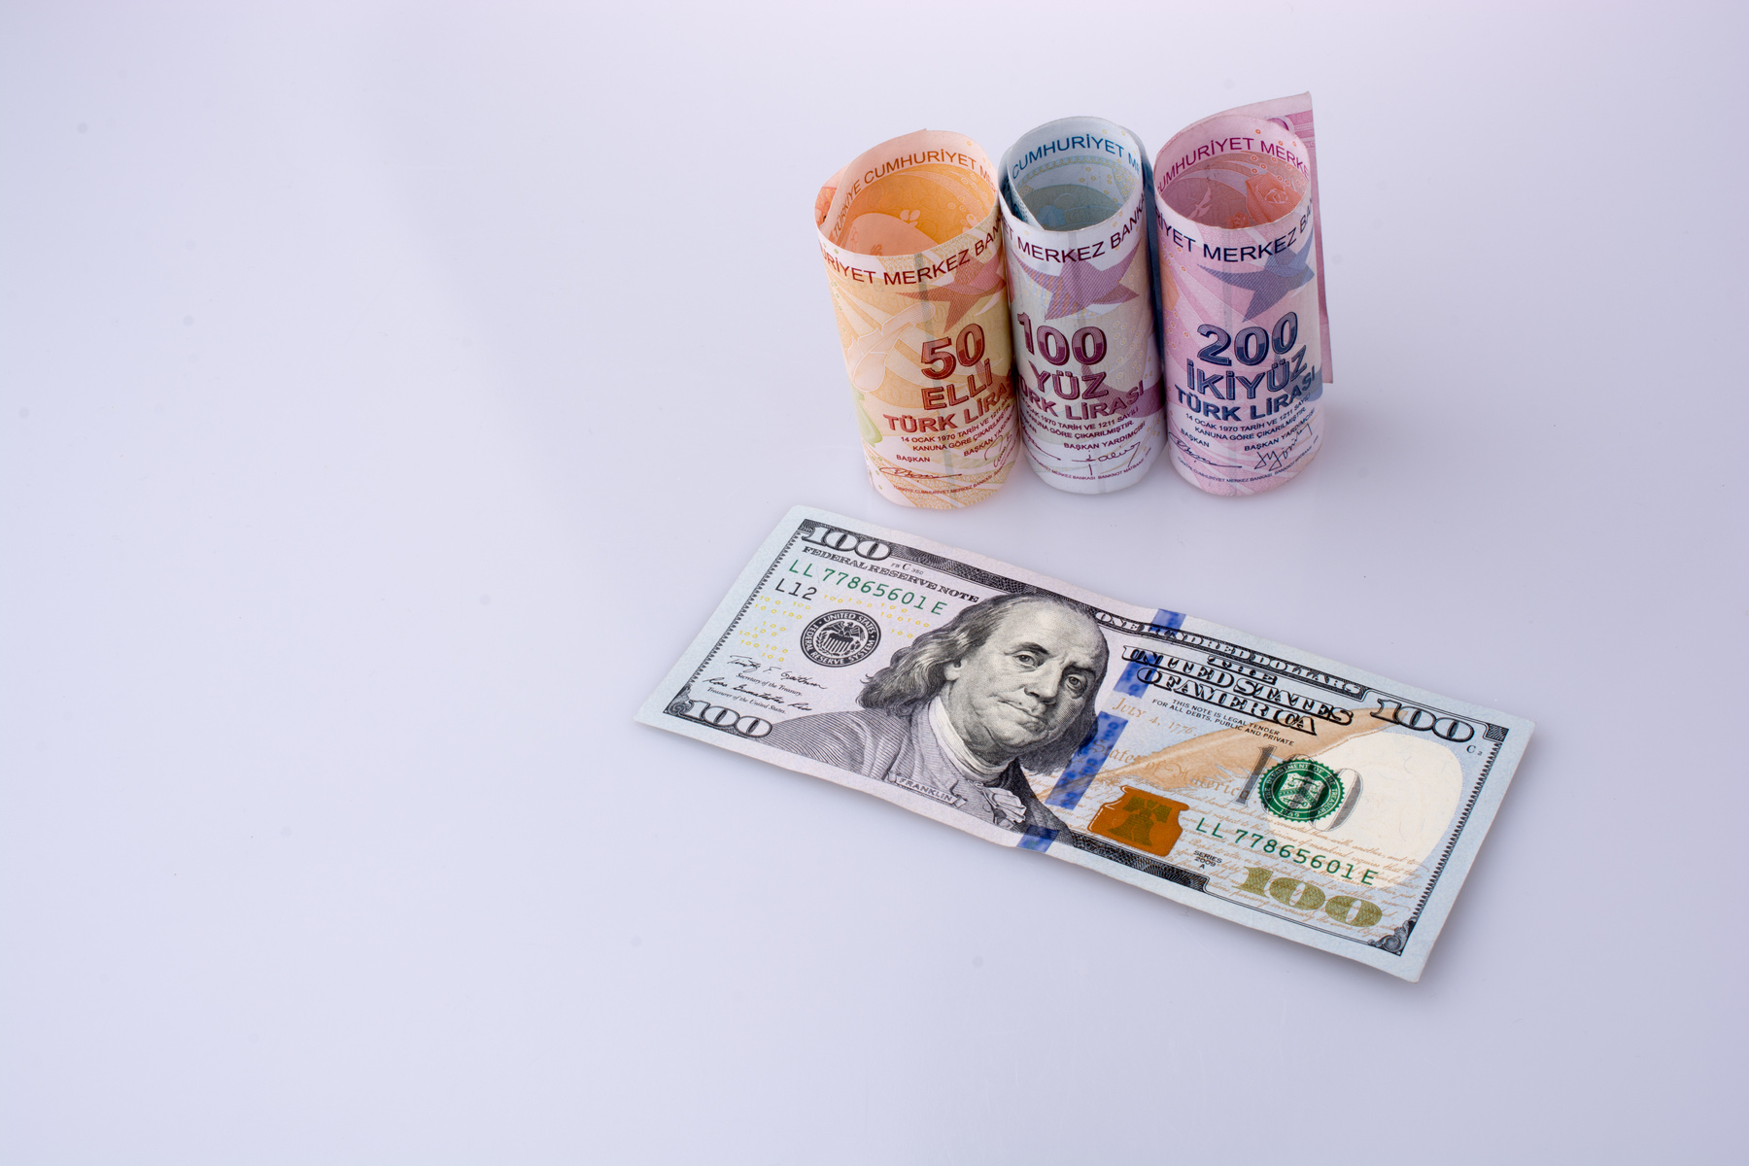
CONCLUSION
During our project, which involves data collection and interpretation stages, we observed that the depreciation of the Turkish lira against other currencies resulted in an increase in the number of tourists and the demand for a way economical experience in Turkey.

Slide 25
THANK YOU FOR
JOINING THIS PRESENTATION!

Slide 26
REFERANCES
Tourism Income, Expenditure and Average Number of Nights, 2012 - 2023
Tourism Income of Turkish Citizens Resident Abroad and Average Expenditure Per Capita, 2012 - 2023
Tourism Income and Average Number of Nights of Turkish Citizens Resident Abroad, 2012 - 2023
Tourism Income of Turkish Citizens Resident Abroad and Average Expenditure Per Capita, 2012 - 2023
Tourism income, number of visitors and average expenditure per capita by months, 2012 - 2023
TURİZM GELİRLERİNİN İHRACAT GELİRLERİ VE TURİZM GİDERLERİNİN İTHALAT GİDERLERİ ORANI
2018-2020 YILLARINDA ÜLKEMİZE GELEN YABANCI ZİYARETÇİLERİN MİLLİYETLERİNE GÖRE KARŞILAŞTIRILMASI (OCAK - EKİM)
OCAK AYINDA GELEN DIŞ HAT YOLCULARININ MİLLİYETLERİNE GÖRE DAĞILIMI
A Geographic view on the Touristic Accommodation Type and Distribution in Turkey
TURİZM GELİRİ, GİDERİ ve ORTALAMA HARCAMANIN YILLARA GÖRE DAĞILIMI
exchange-rates
TUFE-bazlı-reel-efektif-döviz-kuru
ÜLKEMİZE GELEN YABANCI ZİYARETÇİLERİN MİLLİYETLERİNE GÖRE DAĞILIMI (2006 - 2021)

